Slide 1
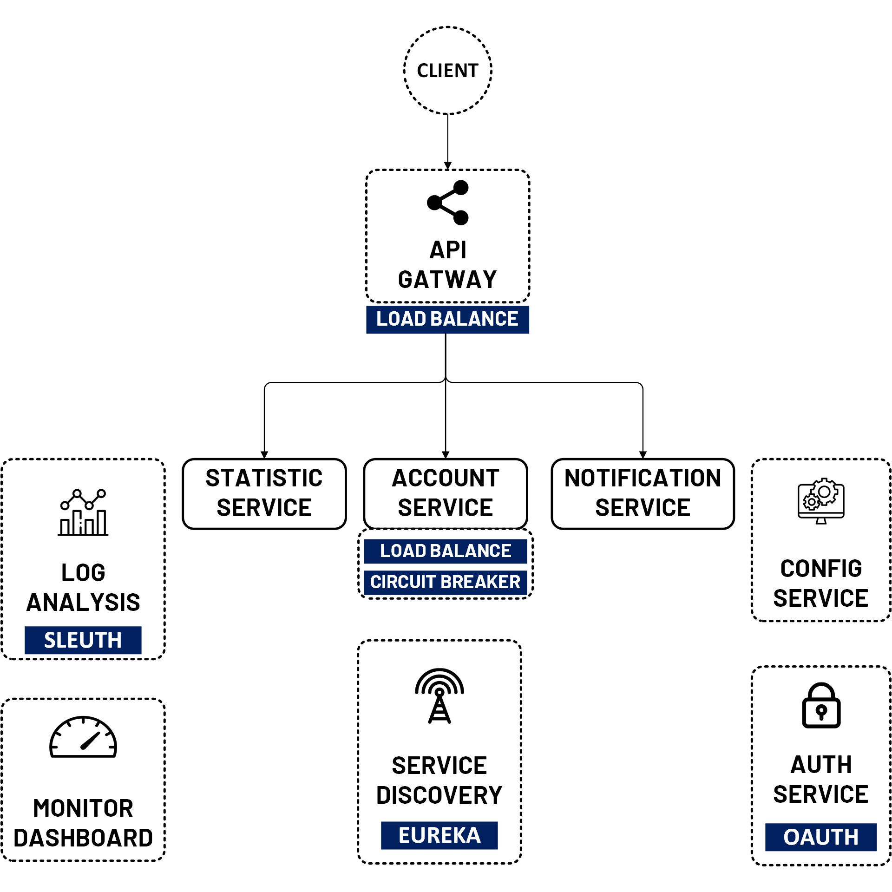

Axios interceptor with Access & Refresh Token
www.jmaster.io/course/microservices-with-spring-cloud

